Slide 1

Salary Prediction
A Machine Learning Project
Presented by: Rahul Ghosh
Guided by : Naina Devi
Techno India university | B.Tech CSE-AI(3rd YEAR)

Slide 2
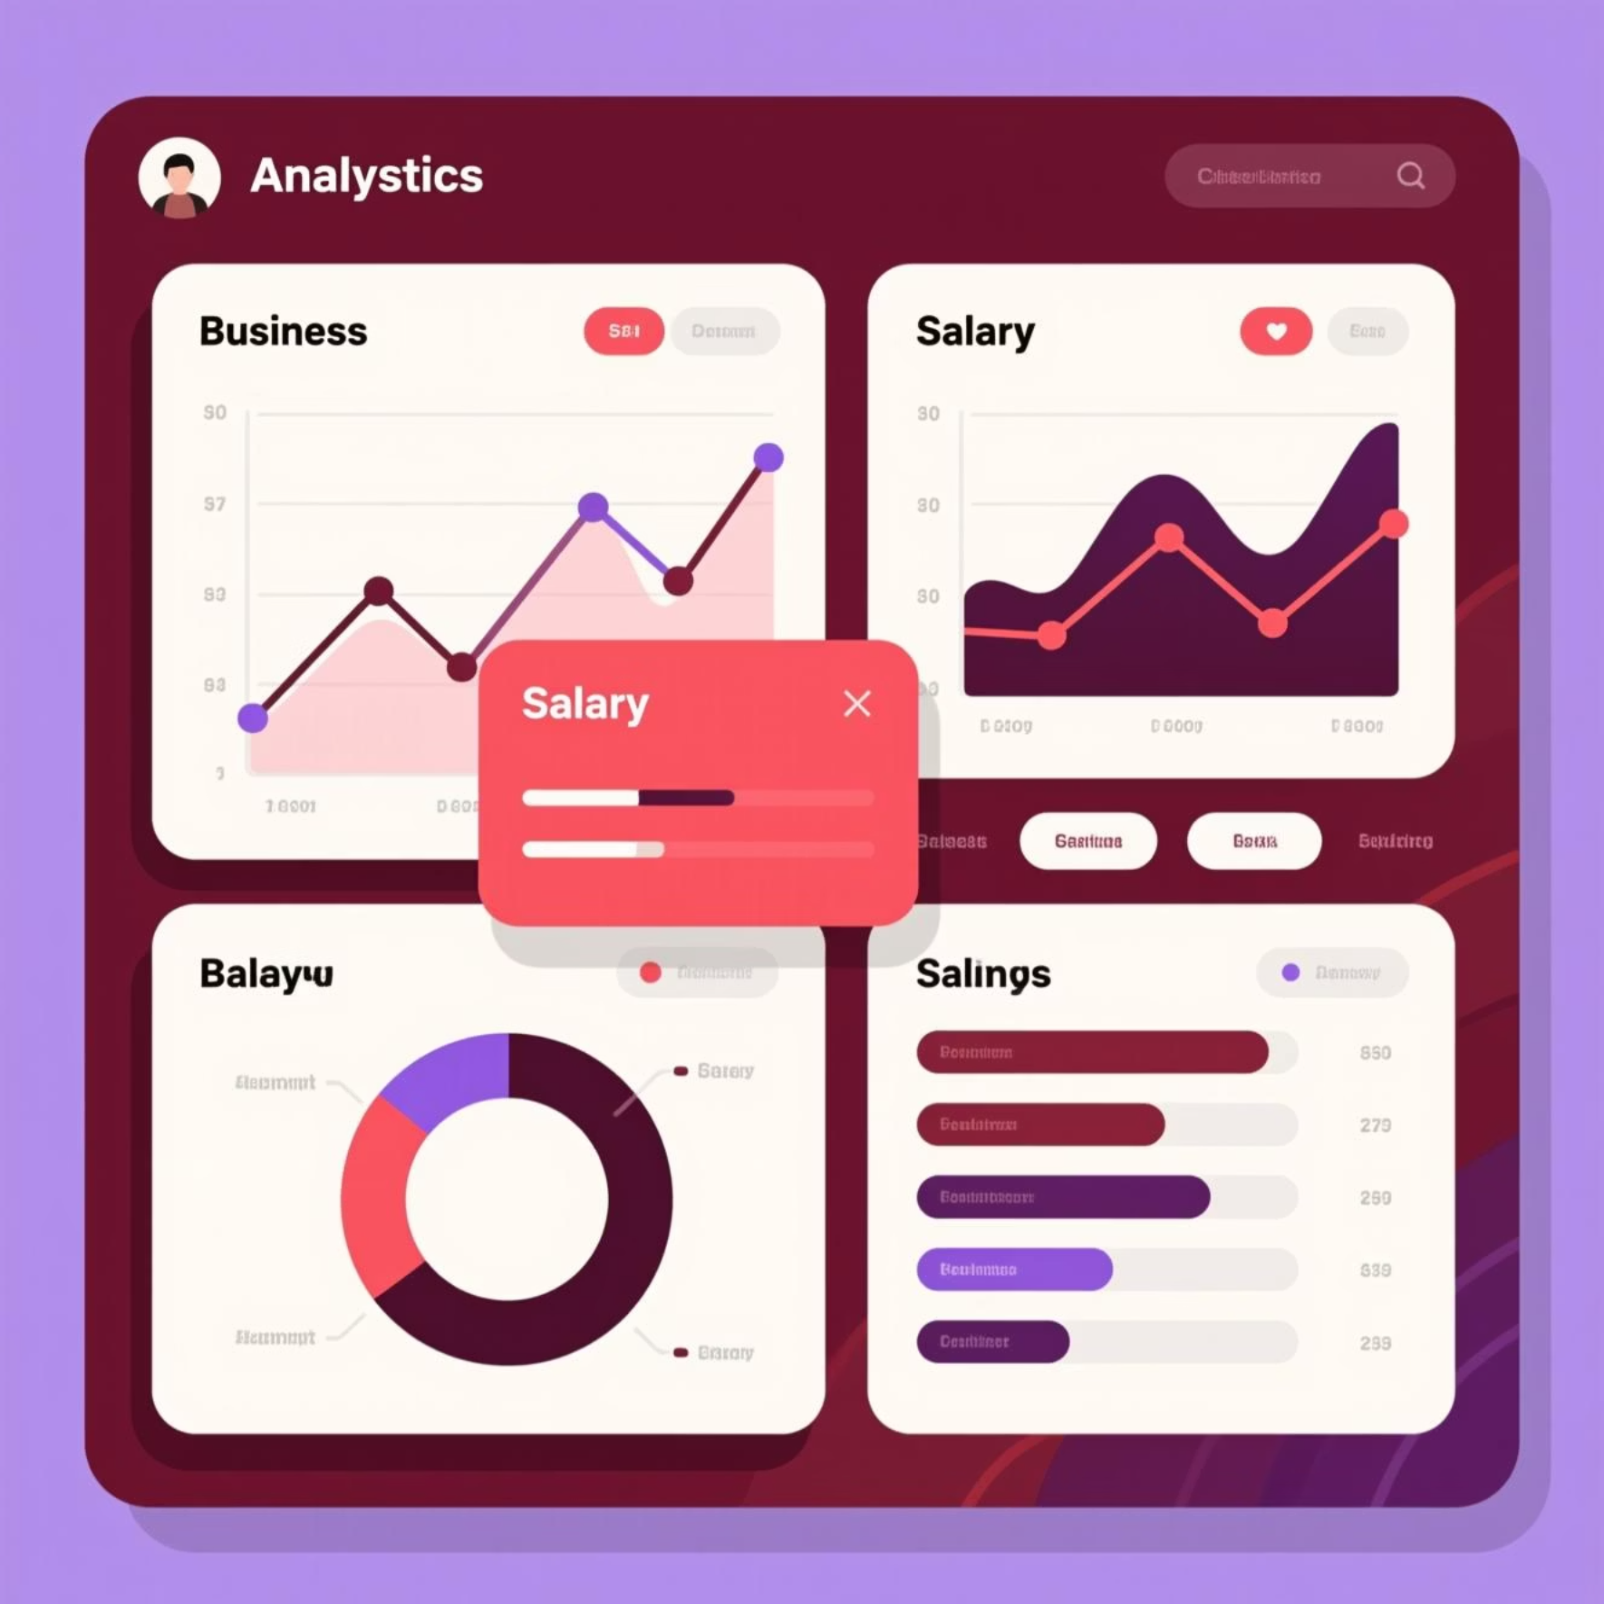




Project Overview and Objectives
What I'm Building
Predictive model analyzing salary patterns across job roles, experience levels, education, and geographic locations
Why It Matters
Helps job seekers understand fair compensation and employers benchmark salary offers
Data Collection
Analysis
Kaggle employee dataset
Explore patterns & correlations
Model Building
Evaluation
Train ML algorithms
Measure accuracy & performance

Slide 3





Dataset Introduction: Kaggle Employee Salary Data
Job Title
50+ unique roles
Data Scientist, Software Engineer, Product Manager, etc.
Experience
0-20+ years
Entry to executive levels
Education
Bachelor's to PhD
Various fields of study
Location
100+ cities
Major tech hubs worldwide
10K+
8
3
Total Records
Key Features
Years Span
Comprehensive dataset for training
Multiple predictive variables
Recent salary trends

Slide 4
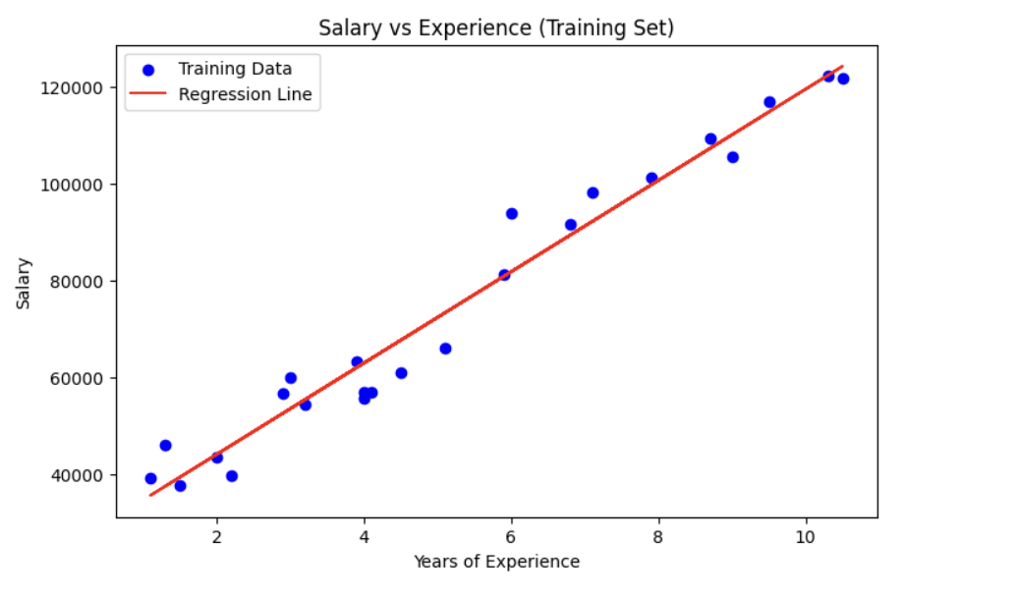
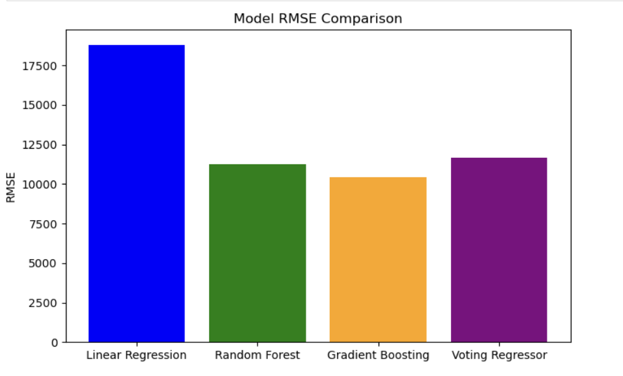
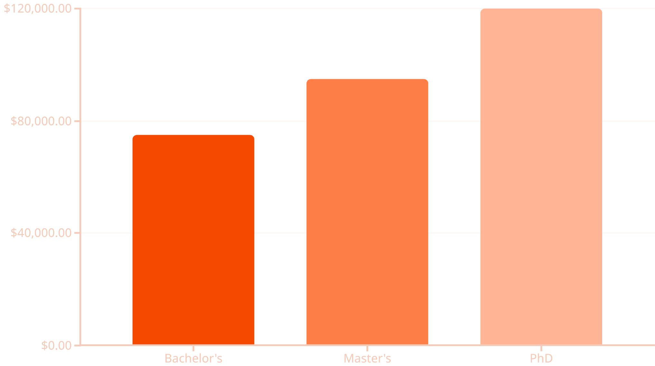
Exploratory Data Analysis and Key Insights
Salary Correlations
Strong positive: Experience years, education level, location (tech hubs)
Moderate: Company size, industry sector
Weak: Gender (concerning), age
Experience Matters Most
10+ years experience = 2.5x entry-level salary

Slide 5
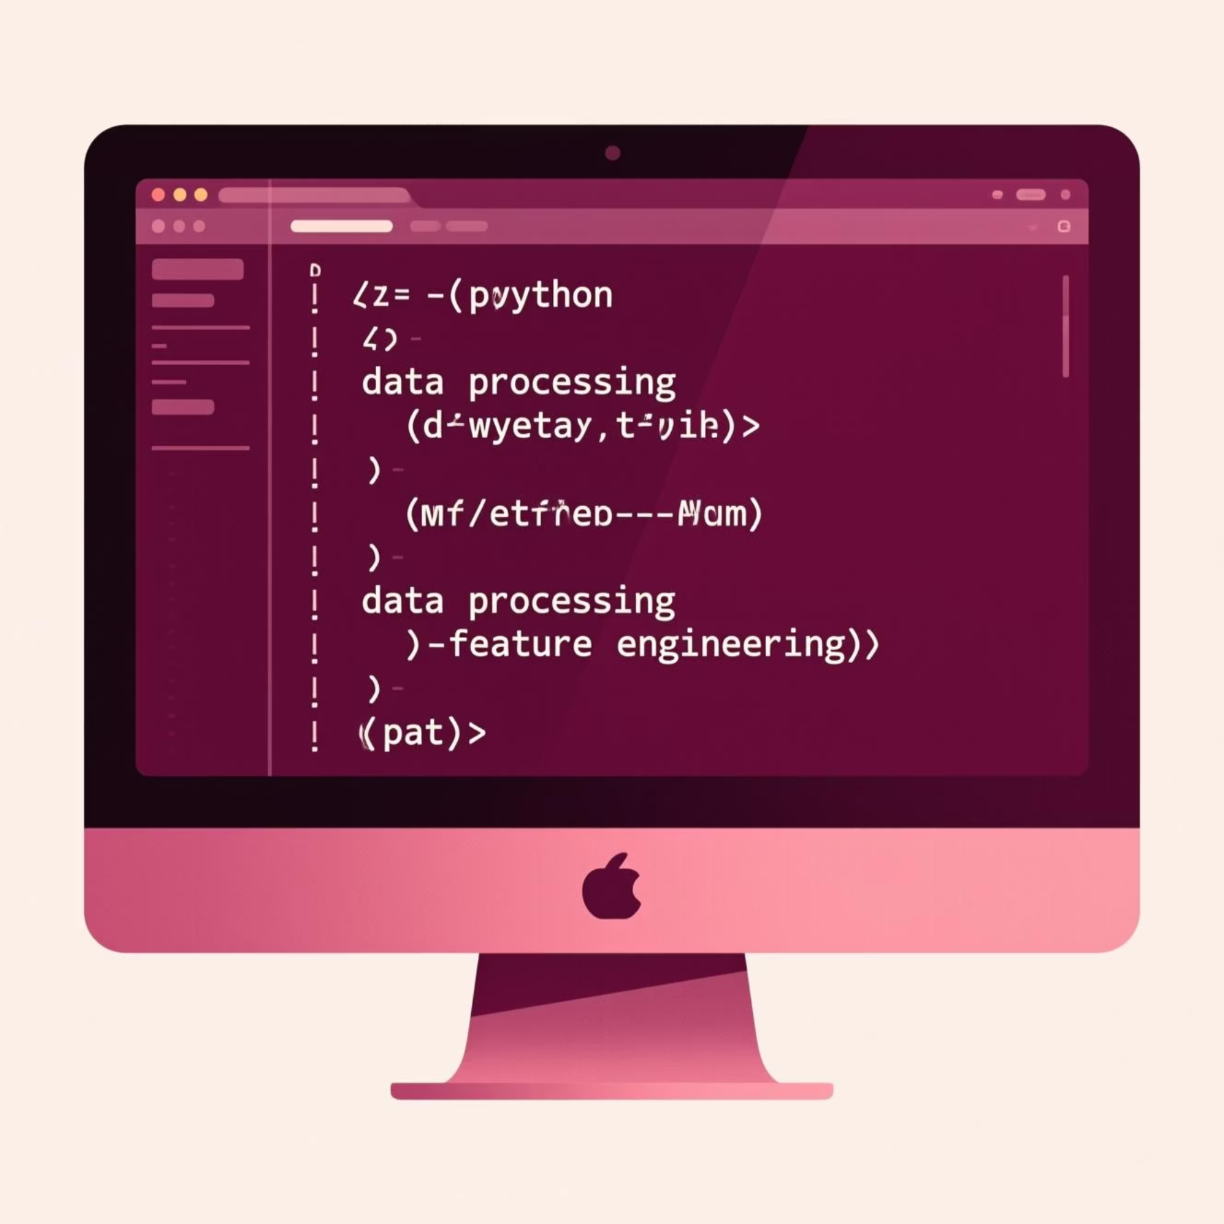
Feature Engineering and Data Preprocessing
Data Cleaning
Encoding
Normalization
Handled missing values (3.2%)
One-hot encoding for job titles
StandardScaler for numeric features
Removed outliers & duplicates
Label encoding for education
Balanced feature importance
New Features Created
Years per Education: Experience relative to degree level
Location Cost Index: Regional salary adjustments
Seniority Score: Combined experience + education metric
Role Category: Grouped similar job functions
Train-Test Split: 80% training, 20% testing • Stratified sampling to preserve salary distribution

Slide 6

Model Selection and Training Approach
Linear Regression
Random Forest
XGBoost
Baseline model • Simple & interpretable
Ensemble method • Handles non-linearity well
Advanced boosting • Best performance
Hyperparameter Tuning
Model Validation
Grid search with 5-fold cross-validation
K-fold CV to prevent overfitting
1
2
3
Feature Selection
Recursive feature elimination (RFE)

Slide 7
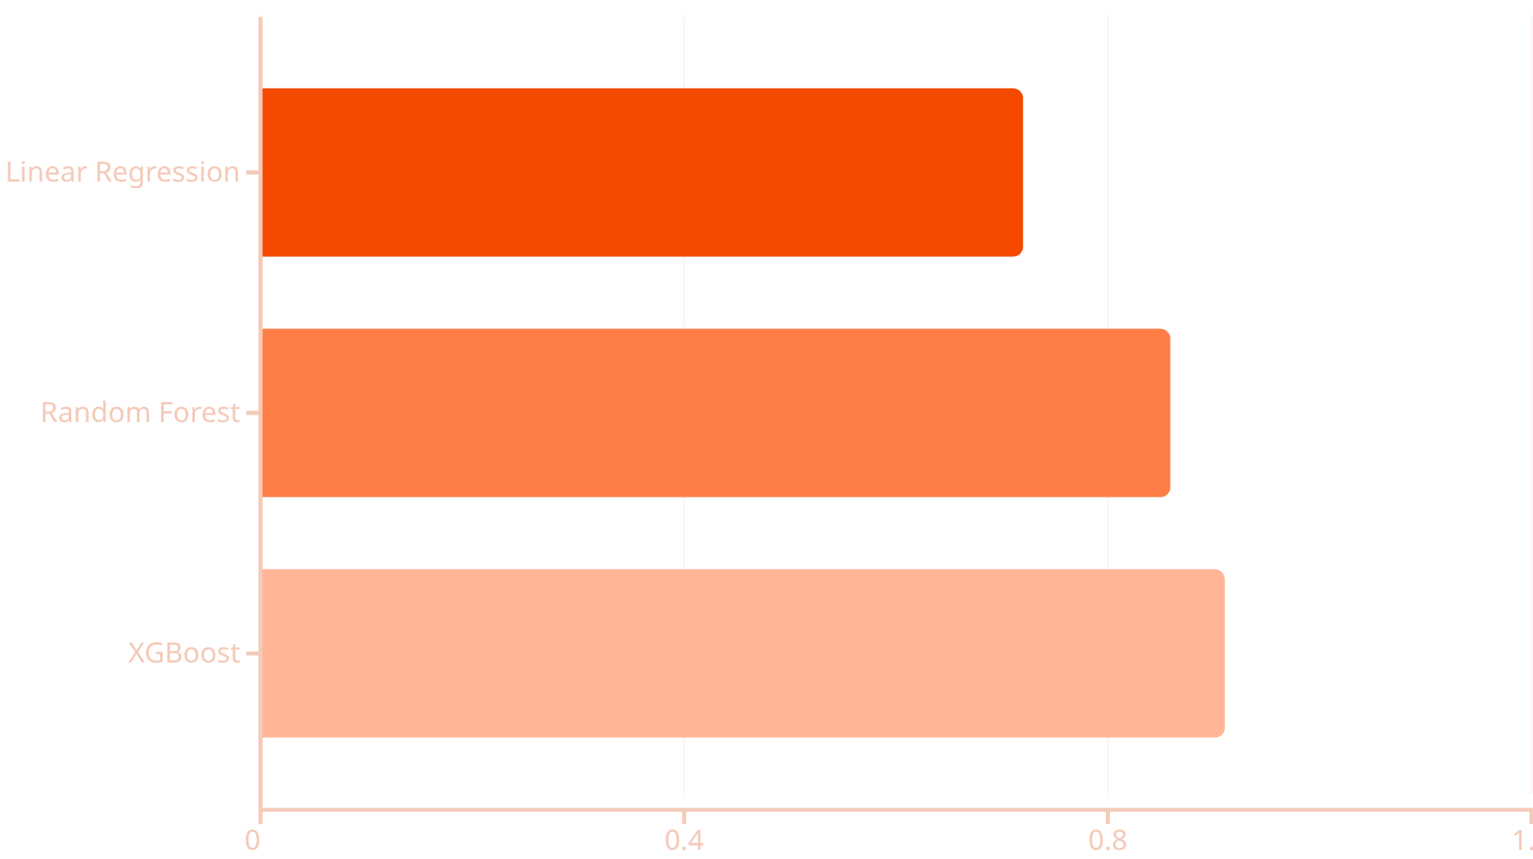
Performance Evaluation and Metrics
R² Score
RMSE
MAE
Measures explained variance
Root Mean Squared Error
Mean Absolute Error
Higher = better fit
Average prediction error
Robust to outliers
Why These Metrics?
R² shows how well features explain salary variance
RMSE penalizes large errors heavily
MAE gives intuitive dollar-amount errors

Slide 8



Results and Model Accuracy Analysis
91% Accuracy
XGBoost achieved highest R² score with minimal overfitting
91%
$8.5K
95%
Model Accuracy
Average Error
Within Range
XGBoost R² on test set
Mean Absolute Error
Predictions ±$15K actual
1
2
Experience Years
Job Title
Most influential feature (38% importance)
Second highest impact (27% importance)
3
4
Location
Education Level
Geographic premium (18% importance)
Foundation factor (12% importance)

Slide 9

Challenges Faced and Lessons Learned
Key Challenges
Imbalanced Data
Senior roles underrepresented • Used SMOTE sampling
High Cardinality
100+ job titles • Created role categories
Multicollinearity
Experience + age correlated • Feature selection helped
💡 Data Quality > Quantity
💡 Start Simple
💡 Domain Knowledge
Cleaning and preprocessing took 40% of project time but dramatically improved results
Linear regression baseline helped understand relationships before complex models
Understanding job market dynamics improved feature engineering decisions

Slide 10





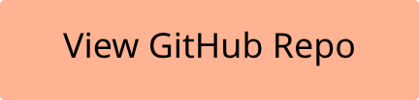

Future Improvements and Next Steps
Real-Time Data
Deep Learning
Integrate live job market API for current trends
Experiment with neural networks for complex patterns
Expand Features
Web Application
Add skills, certifications, company ratings data
Deploy model as interactive salary prediction tool
"This project taught me end-to-end ML workflow: from messy data to deployed model"
— Student reflection

